Slide 1
Department of Mathematics
Clarkson University | Spring 2023

Slide 2
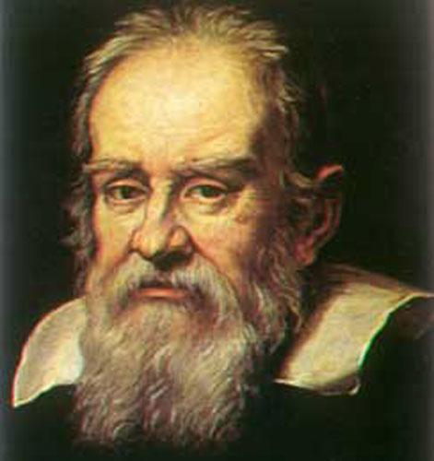
Department of Mathematics
“Philosophy is written in this grand book — I mean the universe — which stands continually open to our gaze, but it cannot be understood unless one first learns to comprehend the language in which it is written. It is written in the language of mathematics, and its characters are triangles, circles, and other geometric figures, without which it is humanly impossible to understand a single word of it; without these, one is wandering about in a dark labyrinth.”
— Galileo Galilei
‹#›

Slide 3
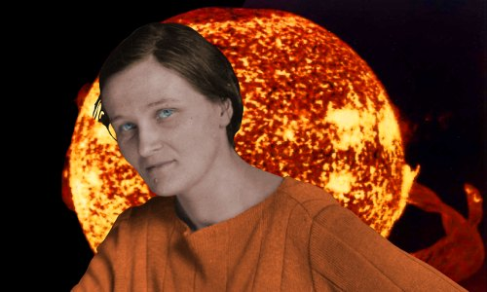
Department of Mathematics
“Young people, especially young women, often ask me for advice. Here it is, valeat quantum. Do not undertake a scientific career in quest of fame or money. There are easier and better ways to reach them. Undertake it only if nothing else will satisfy you; for nothing else is probably what you will receive. Your reward will be the widening of the horizon as you climb. And if you achieve that reward you will ask no other.”
— Celia Payne-Gaposchkin
‹#›

Slide 4
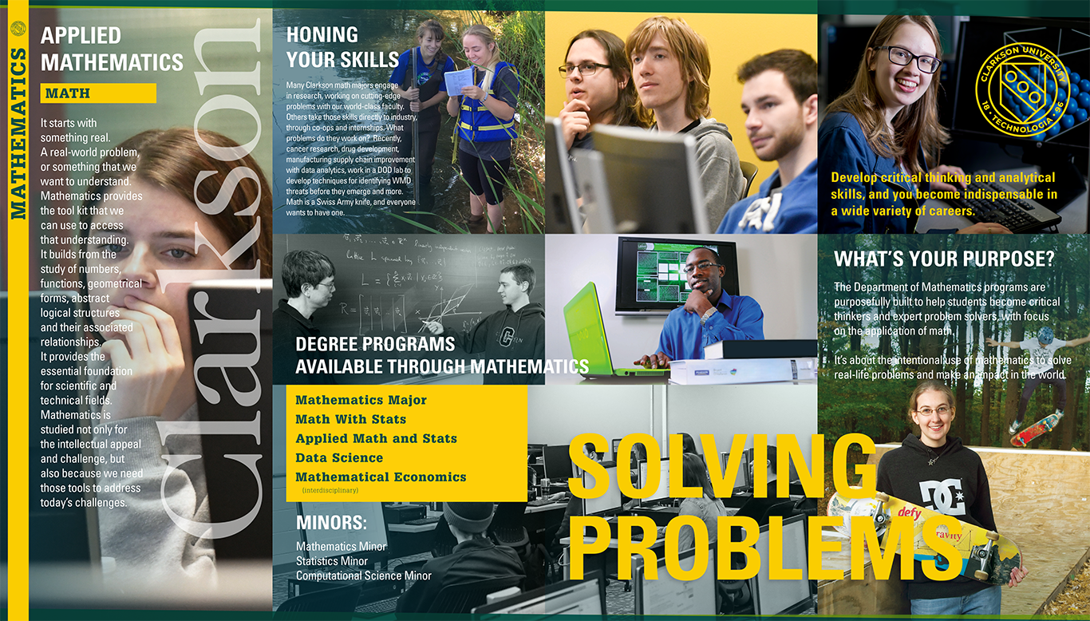
Department of Mathematics
‹#›

Slide 5
The Math Major ensures preparation for graduate studies but maintains significant flexibility, especially in the senior year.
First Year
Fall
MA131 Calculus I
CS141 Comp Sci I (4)
PH131 Physics I (4)
UNIV 190 CU Seminar
FY100 First Year Seminar (1)
Spring
MA132 Calculus II
CS142 Comp Sci II*
PH132 Physics II (4)
MA200 Math Modeling
Knowledge Area elective
Sophomore Year
5 required MA courses
1 Science elective
2 Knowledge Area electives
2 Free electives
Junior Year
2 required MA courses
3 MA/STAT elective
2 Knowledge Area electives
3 Free electives
Senior Year
2 MA/STAT electives
Professional experience
8 Free electives

Slide 6
The Applied Math and STATS Major uses focused electives to emphasize to industrial and business application of mathematics.
First Year
Fall
MA131 Calculus I
CS141 Comp Sci I (4)
PH131 Physics I (4)
UNIV 190 CU Seminar
FY100 First Year Seminar (1)
Spring
MA132 Calculus II
CS142 Comp Sci II*
PH132 Physics II (4)
MA200 Math Modeling
Knowledge Area elective
Sophomore Year
5 required MA courses
1 Science elective
2 Knowledge Area electives
2 Application/Free electives
Junior Year
3 required MA courses
2 MA/STAT elective
2 Knowledge Area electives
3 Application/Free electives
Senior Year
2 MA/STAT electives
Professional experience
7 Free electives
1 Application elective

Slide 7
The Data Science Major leverage CS and Information Systems to build a unique 21st century skillset to address the data challenge.
First Year
Fall
MA131 Calculus I
CS141 Comp Sci I (4)
Science Elective(4)
UNIV 190 CU Seminar
FY100 First Year Seminar (1)
Spring
MA132 Calculus II
CS142 Comp Sci II*
Science Elective (4)
MA200 Math Modeling
Knowledge Area elective
Sophomore Year
4 required MA courses
Intro to Data Science
2 Knowledge Area electives
3 CS/IS courses
Junior Year
2 required CS/IS courses
2 MA/STAT required
2 Knowledge Area electives
3 Free electives
Data Ethics
Senior Year
2 MA/STAT electives
Professional experience
5 Free electives
2 Application elective

Slide 8
Don’t let the menu confuse: your first year choice is completely flexible.
Math
Fall
MA131 Calc
CS141 CSci I
PH131 Phys I
UNIV 190
FY100
Spring
MA132 Calc II
CS142 CSci II*
PH132 Phys II
MA200 Modeling
Knowledge Area
AMS
Fall
MA131 Calc
CS141 CSci I
PH131 Phys I
UNIV 190
FY100
Spring
MA132 Calc II
CS142 CSci II*
PH132 Phys II
MA200 Modeling
Knowledge Area
DS
Fall
MA131 Calc
CS141 CSci I
Science (Take Phys)
UNIV 190
FY100
Spring
MA132 Calc II
CS142 CSci II*
Science (Take Phys)
MA200 Modeling
Knowledge Area

Slide 9
Department of Mathematics
‹#›

Slide 10
Our Graduates do lots of different things, and none with the title of “mathematician.”
 | Alicia | 19 | Math | Manufacturing Analyst | SRCTec
 | Toop | 19 | AMS | Graduate | Northeastern U.
 | Chris | 19 | AMS | Data Sci | Harris Corp., Rochester
 | Sam | 19 | Math&CS | Software Developer | Epic, WI
 | Gary | 18 | Math&CS | Electrician | Old Forge Elec, NY
 | Jacob | 18 | Math&CS | Google | LA
 | Jheilyno | 18 | AMS | Country Living Loans | Northeast US
 | Lauren | 18 | AMS | Graduate | Iowa State U.
 | Warren | 18 | AMS | MAT | Clarkson U.
 | Evan | 17 | Math | Market Research, IRI | Chicago
 | Ahmed | 16 | Math | Language Data Analyst | NY
 | Carrie | 16 | Math | Data Scientist | NY
 | Ahmed | 16 | Math | Language Data Analyst | NY
 | Nick | 14 | Math | Lecturer | The Ohio State
 | Peter | 14 | AMS&Phy | Data Scientist | Cornell U.
 | Ruby | 10 | Math | Miller Institute for Basic Research in Sci | UC Berkeley
Dr
Dr

Slide 11
The career space for math majors is incredibly diverse.
Jayesh Bokhiria (15) – GE Transportation – Locomotive control system validation and simulation.
Carrie Galgano (15) – Teacher
Emily Metruck (13) – IBM – Software Test Engineer
Ahmed Elborolosy – X.AI - tech started in AI applied to travel arrangements
Peter Vaillancourt (15) – Cornell Data Analytics Consultancy
Candace Liu (14) – EPIC – Technical Services
Carrie Rider and Kevin Gibson (15) – Booz Allen – Data Scientist
Jacob Baldwin (17) – AIS – Computer Engineer
Iman Khondker (11) – Pixel Academy
Steven Foti (11) – Director of Online MS in Biostatistics at U of Florida
Arianne Loeber (13) – GE Oil and Gas – Project Quality Leader
Devin Willis (17) – Canton Potsdam Hospital – Quality of Care analytics

Slide 12
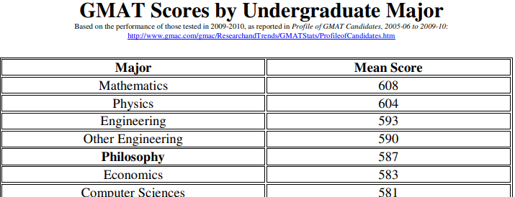
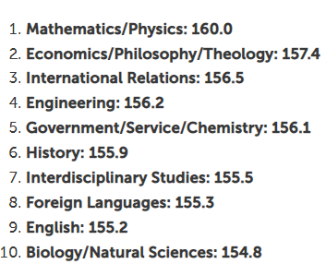
Studying Math develops your critical thinking skills
MCAT
LSAT

Slide 13
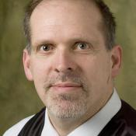
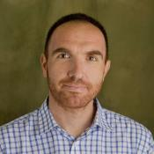
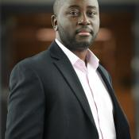
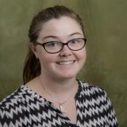
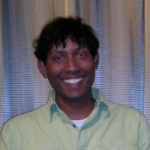
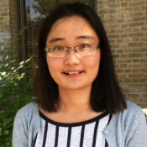
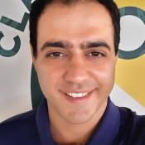
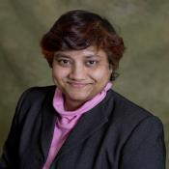
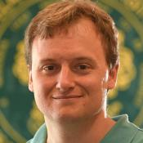
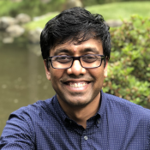
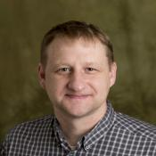
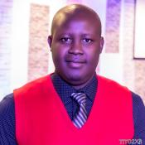
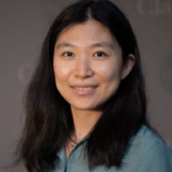
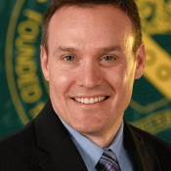
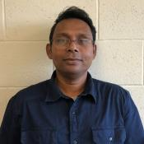
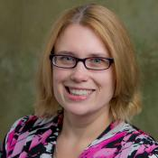
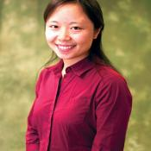
Math Faculty

Slide 14
Clarkson Distinctives
Small College plus Graduate Program:
Courses taught by faculty
Personal advising
Professors available for help
Graduate courses available to well-prepared undergrads
Active Faculty:
Faculty committed to both teaching and research Brings relevant applications and interest into classes Supported by NSF, DOD, DOE, and other agencies
Collaborations with many groups at Clarkson and beyond
You may get involved (for credit—or possibly paid)

Slide 15
More Opportunities
Associated Colleges—up to two courses per year at:
SUNY/Potsdam: music, education, liberal arts, languages, . . .
Saint Lawrence University: liberal arts, languages, music, . . .
SUNY/Canton: criminal justice, health care, veterinary tech, . . .
Co-op Programs and Internships:
Actuarial trainee
Work in industry or at a research laboratory
Undergraduate Research
Work with a professor at Clarkson
Summer research: NSF/REU, national labs, . . .
Honors program thesis work
Study Abroad Exchange: 23 countries, 44 universities
Math Club: AWM, SIAM, Pi Mu Epsilon

Slide 16
Our Graduate Programs
Data Analytics (MS)
Healthcare Data Analytics (MS)
Master of Arts in Teaching (MAT)
Mathematics (MS, PhD)
Physics (MS, PhD)

Slide 17
Nearly 40 Minors, Concentrations and Professional Advising Tracks
HEALTH
Medicine & Healthcare
Pre-Health Sciences (advising tracks for Pre-Dental, Pre-Med, Pre-Optometry, Pre-OT, Pre-PA, Pre-PharmD, Pre-PT,) Pre-Vet
ENVIRONMENTAL
Environmental Engineering
Environmental Health Science
Environmental Science and Policy
Sustainable Energy Systems Engineering
Sustainable Solutions for the Developing World
ARTS & SCIENCES
Applied Mathematics and Statistics
Biology
Biology, Behavior & Society
Biomedical Science & Technology
Biomolecular Science
Biomedical Science & Technology
Chemistry
Cognitive Neuroscience
Computational Science
Communication, Media & Design
Computer Science
Data Science
Digital Arts & Sciences
History
Humanities
Liberal Studies
Mathematics
Physics
Political Science
Psychology
Social Sciences
Social Documentation
BUSINESS & COMMUNICATION
Accounting (concentration)
Business
Corporate Innovation
Economics
Human Resource Management
Information Technology
Quality-Based Project Management
Business Intelligence & Data Analytics
Global Supply Chain Management
Innovation and Entrepreneurship
Financial Information and Analysis
Engineering and Management
ENGINEERING
Biomedical Engineering
Aerospace Engineering
Civil Engineering
Environmental Engineering
Computer Engineering
Chemical Engineering
Mechanical Engineering
Electrical Engineering
Robotics
Software Engineering
LAW
Law Studies
Pre-Law (advising track)
TEACHING
Pre-Teaching

Slide 18
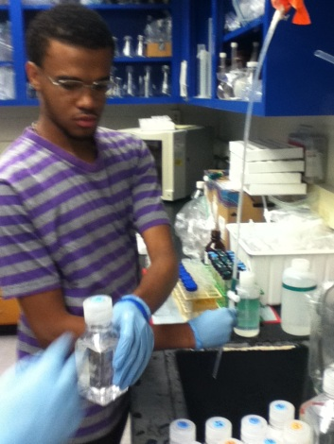
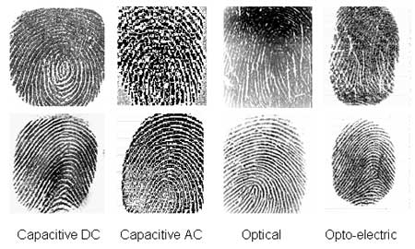
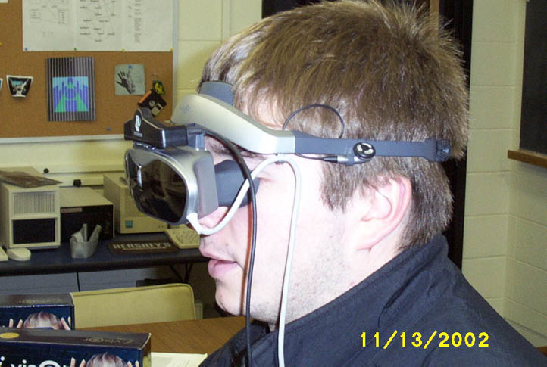
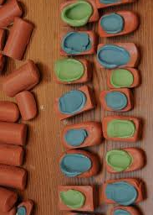
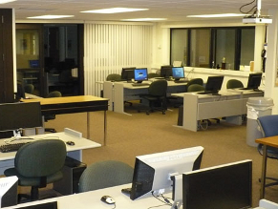
More Opportunities
Minors
Computer Science
Software Engineering
Computational Science
Information Technology
Communication
...
Labs and projects
COSI, ITL, VRDL
Undergraduate research
Talk with faculty

Slide 19
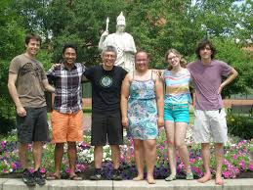
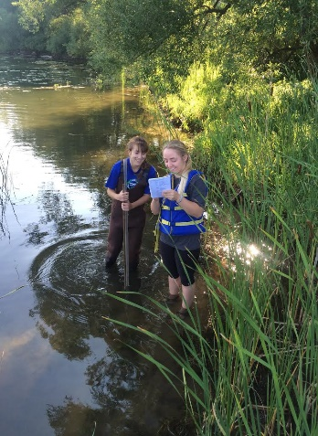
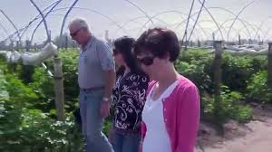
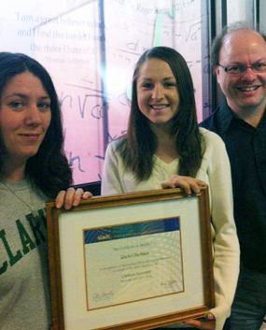
Even More Opportunities
Study Abroad Exchange
Co-ops and Internships
Actuarial Science
Course work
Exams
Internships
Math Club(s)
AWM
SIAM
Pi Mu Epsilon

Slide 20
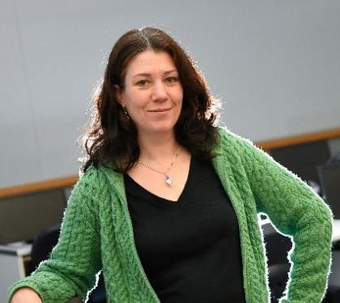
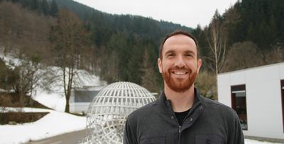
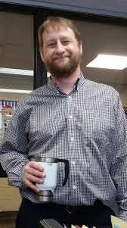
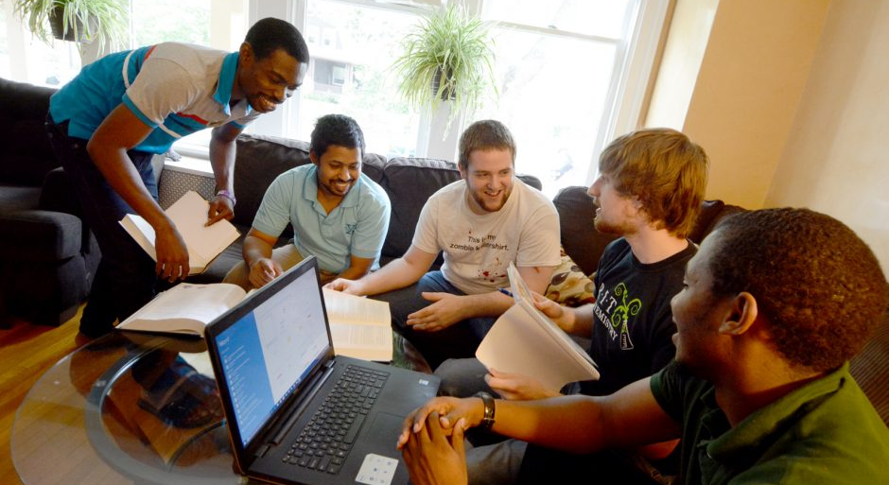
Advising and Mentorship
Academic Advisors
Meeting in early November for Spring course selection
Consult each semester for course selection
Available for program/academics questions any time
Course Instructors
TAs
Department Chair and Executive Officer

Slide 21
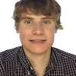
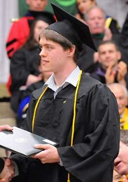
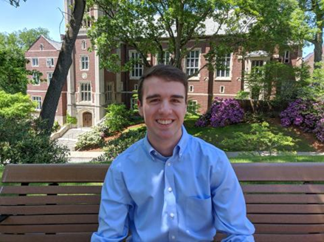
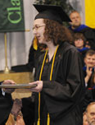
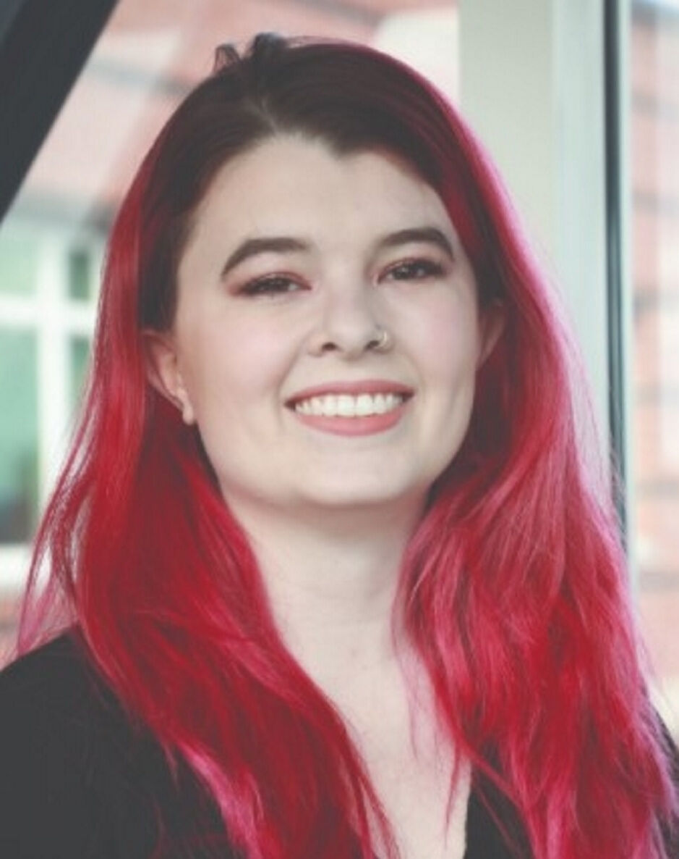
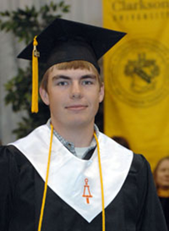
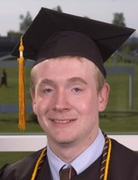
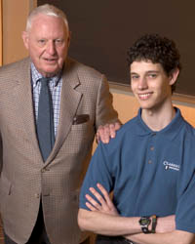
Math Majors Excel
Ryan Burnham
2019
Ruby Fu
2011
Leah Granger
2016
Nick Marshall
2014
Jamie Davis
2012
Emily Stefano
2011 - (Mech Eng w/math honors thesis advisor)
Jason Holloway
2010 (w/math honors thesis advisor)
Noah Chicoine
2020
Autumn Lemon (Mech Eng)
Kristen Goebel
Andrew Davis
2010
Matt Parno
2009
Matt Williams
2007
Adam Searleman
2006
Izzi Grasso
2021
Niall Mangan
2008

Slide 22
Oncology

Slide 23
Fluid Mechanics

Slide 24
Biology

Slide 25
We look forward to seeing you in the Fall of 2023!
clarkson.edu/math

